Slide 1
IGNAZ SEMMELWEIS AND THE DETERMINATION OF THE CAUSE OF PUERPERAL FEVER
Yan Liu
Zeyu Bian

Slide 2
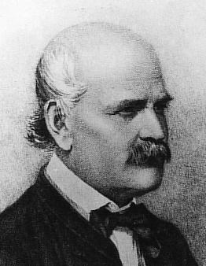
Ignaz Semmelweis
“Saviour of mothers”
An early pioneer of antiseptic procedures
Reduced mortality of puerperal fever
The first one who really described data as an epidemiologist

Slide 3
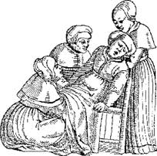
Puerperal Fever
Most common cause of maternal mortality in the 18th centuries
Bacterial infections
Female reproductive tract
After childbirth or miscarriage

Slide 4
Puerperal Fever
Symptoms:
  Fever
  Lower abdominal pain
  Bad-smelling vaginal discharge
Risk factors
  Multiple vaginal exams
  Premature rapture of membranes
Notes:
a very common cause of death around the time of childbirth starting in at least the 18th century until the 1930s when antibiotics were introduced

Slide 5
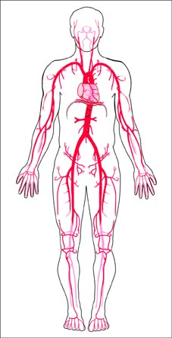
Puerperal Sepsis
A potential complication of maternal infections
Bacteria invades the bloodstream
Cause inflammation of the whole body
  Meningitis
  Pleuritis
  Pericarditis
  Peritonitis

Slide 6
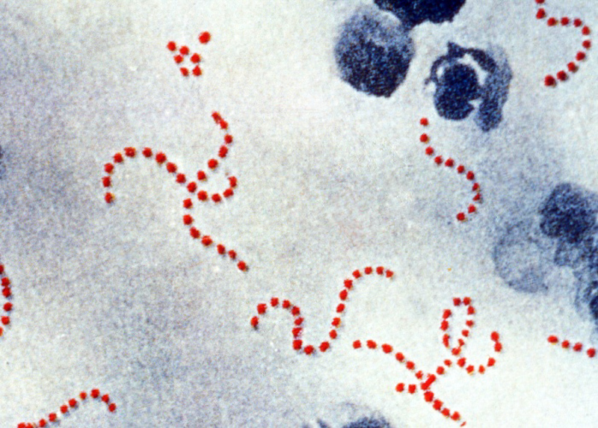
Beta haemolytic streptococcus
https://en.wikipedia.org/wiki/File:Streptococcus_pyogenes.jpg

Slide 7
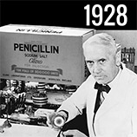
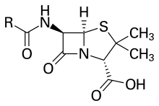
Penicillin

Slide 8
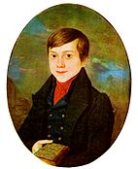

Ignaz Semmelweis
  Born on July 1, 1818 in Hungary
  Be awarded doctorate degree in medicine in 1844
  Be an assistant in the First Obstetrical Clinic of the Vienna General Hospital on July 1, 1846

Slide 9
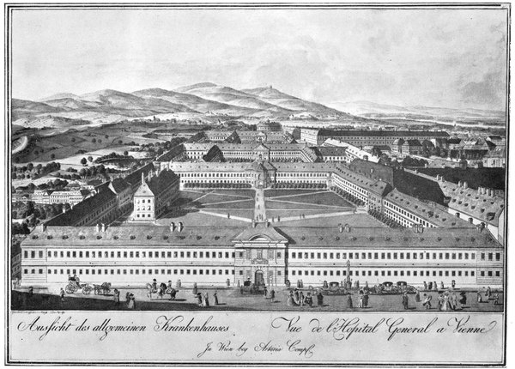
The Vienna General Hospital ( 1784 )
https://en.wikipedia.org/wiki/File:AAKH-1784.jpg

Slide 10
Two maternity wards
  In one women were attended to by doctors
  In the other by midwives
Patients were allocated to the clinics on alternate days
From 1840-1846 in two clinics
  42,795 births
  2,977 deaths

Slide 11
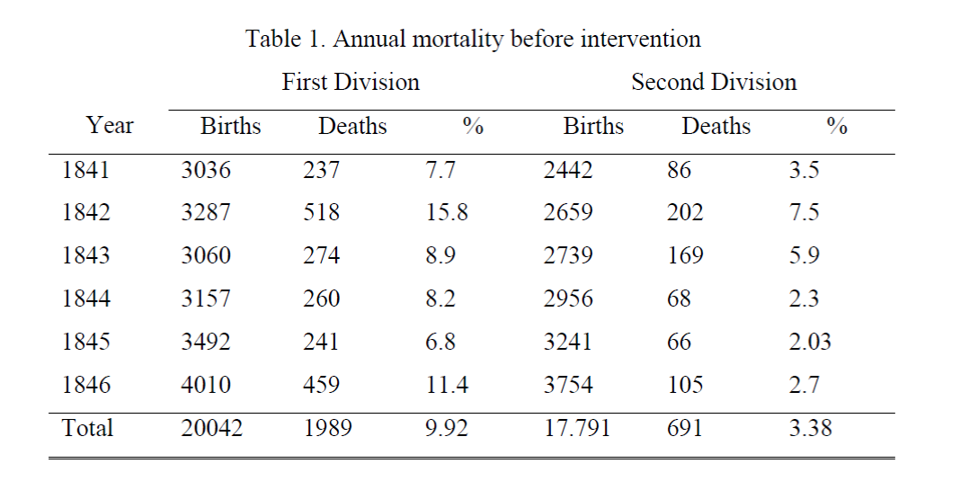
Table 1 is based on page 356 of the book of Semmelweis: The Etiology, The Concept, and the Prophlaxis of Childbed Fever.

Slide 12
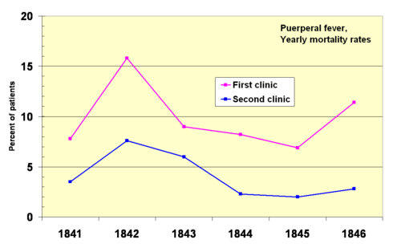
Puerperal fever mortality rates for the First and Second Clinics at the Vienna General Hospital 1841–1846.
https://en.wikipedia.org/wiki/Ignaz_Semmelweis

Slide 13

The Miasm Theory?
Dominant theory to explain the spread of childbed fever in the early 1800s in Europe
Simply postulate that disease was carried by the air

Slide 14
  Semmelweis started a meticulous process of eliminating all possible differences
    Food
    Linen
    Position for delivery
    Medical attention and treatment

Slide 15

Semmelweis wrote:
“Everything was uncertain,
everything was doubtful,
everything was inexplicable,
only the enormous number of deaths is indubitable fact.”
Film--Semmelweis
https://vimeo.com/177467055

Slide 16
Breakthrough
  In 1847, Dr. Jakob Kolletschka had died
  His autopsy showed a pathology similar to that of the women who were dying from puerperal fever

Slide 17
Revelation
  Childbed fever wasn't something only women in childbirth got sick from.
  It was something other people in the hospital could get sick from as well.

Slide 18
Hypothesis
  Connection between cadaveric contamination and puerperal fever
  Morbid matter on doctors’ hands
  Midwives were not engaged in autopsies

Slide 19
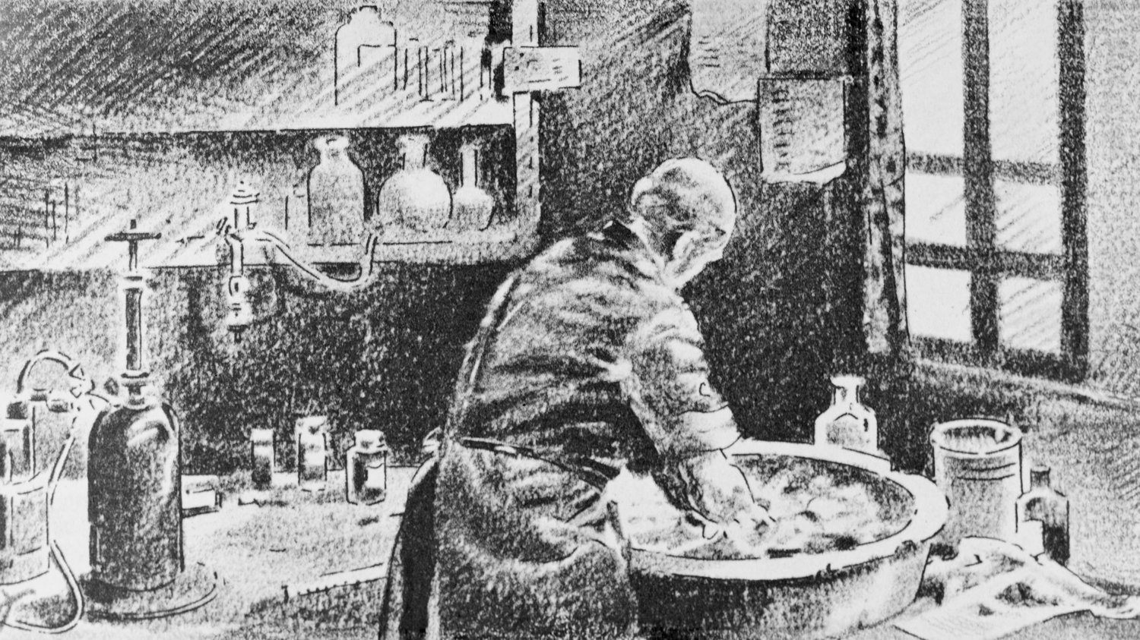
Test
  Ordered his medical staff to start cleaning their hands and instruments with a chlorine solution.

Slide 20
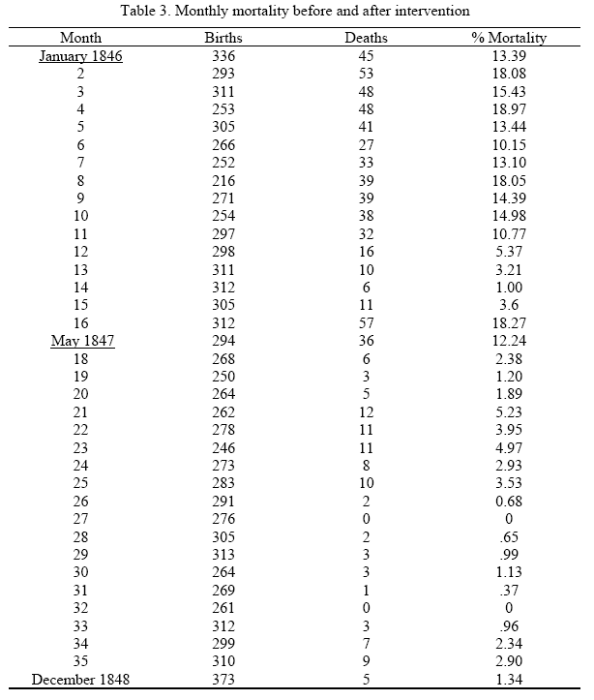

Slide 21
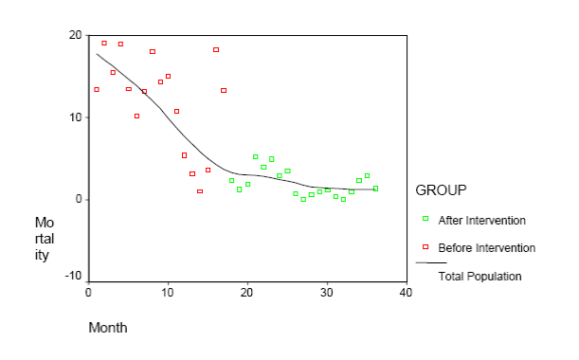
Mortality rate versus month, before and after intervention

Slide 22
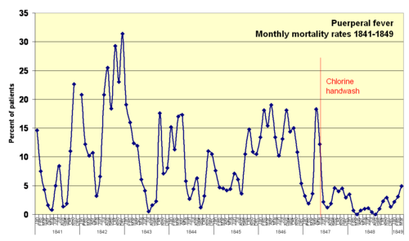
Puerperal fever monthly mortality rates for the First Clinic at Vienna Maternity Institution 1841–1849. Rates drop markedly when Semmelweis implemented chlorine hand washing mid-May 1847
https://en.wikipedia.org/wiki/Ignaz_Semmelweis

Slide 23
However…
  Doctors were upset
  Eventually doctors gave up the chlorine hand-washing
  Semmelweis lost his job

Slide 24
Sad ending
  Semmelweis developed a mental condition over years
  In 1865, Semmelweis was committed to a mental asylum and died a fortnight later
  During his lifetime and for many years after his death, he had few supporters, and his work was almost totally forgotten

Slide 25
Antisepsis
  Antisepsis was not introduced routinely into obstetric practice until the 1880s, when the role of bacteria had been discovered and the use of antisepsis in surgery had become firmly established by Joseph Lister

Slide 26

Roddick Gates

Slide 27
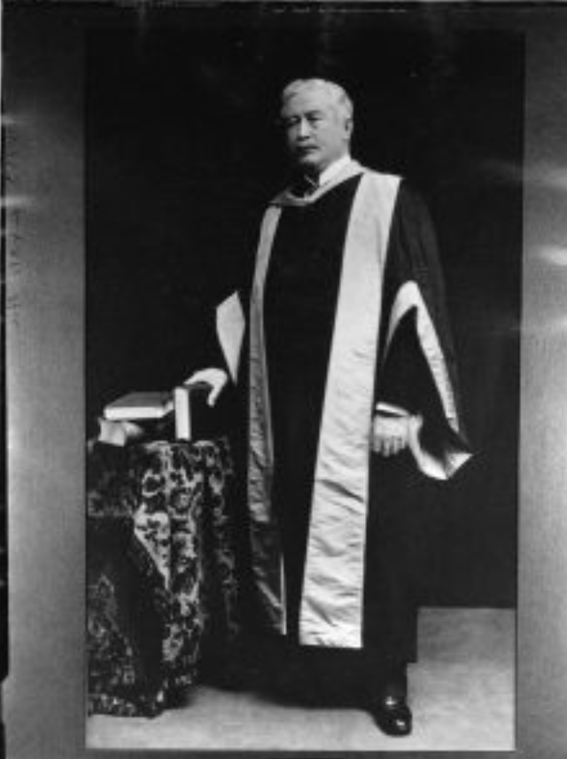
Dr. Thomas Roddick
  A surgeon who visited Lister in 1872 and brought antiseptic practices to Canada
  The former Dean of Medicine at McGill
  Roddick’s particular contribution is that he was the first in Canada to do antisepsis comprehensively
Hand Hygiene
https://www.youtube.com/watch?v=i38sgmWrSfo

Slide 28
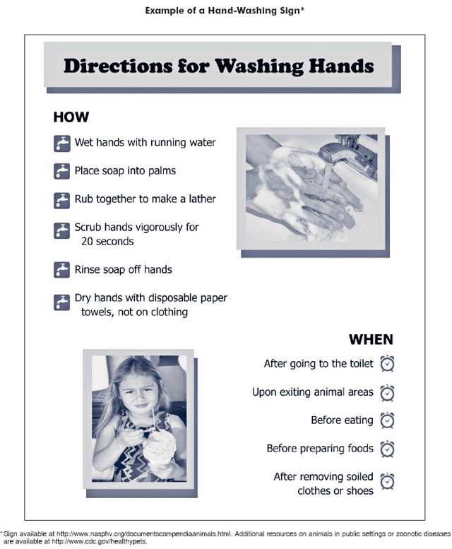

Slide 29
Reference
Broemeling, Lyle D. "Studies in the history of probability and statistics: Semmelweis and childbed fever. A statistical analysis 147 years later.“
Davis, Rebecca. "The Doctor Who Championed Hand-Washing And Briefly Saved Lives." Podcast on NPR Morning Edition (2015).
Loudon, Irvine. "Ignaz Phillip Semmelweis' studies of death in childbirth." Journal of the Royal Society of Medicine 106.11 (2013): 461-463.

